Slide 1
Building an Efficient RDF Store Over a Relational Database

Slide 2
Outline
Introduction
RDF over Relational
Predicate to Column assignment
Graph Coloring
Querying RDF
SPARQL Optimizer
SPARQL to SQL Translator
Evaluation and Experiments
Conclusion

Slide 3
Introduction
Triple store, Type-­Oriented (Jena 1,2) and predicate-­oriented (SW Store and Hexastore) are not flexible and scalable enough.
New mechanism of relational representation of RDF data based on entity
Flexible enough to handle dynamic changes in schema.
Scalable for most complex queries.
Hybrid approach to efficient querying mechanism.
Build data flow structure based on inter-­relationships.
Use this structure and statistics costs to determine best query plan.
Efficient mechanism for SPARQL to SQL translation irrelevant of RDF

Slide 4
RDF over Relational
Hybrid approach
Implement the flexibility of triple store to add triples but in column fashion
Predicate gets assigned to columns like
predicate-­oriented approach but dynamically
Direct Primary Hash -­ each tuple stores a subject s in the entry column, with all its associated predicates and objects stored in the pred(i) and val(i) columns 0≤i≤k respectively

Slide 5
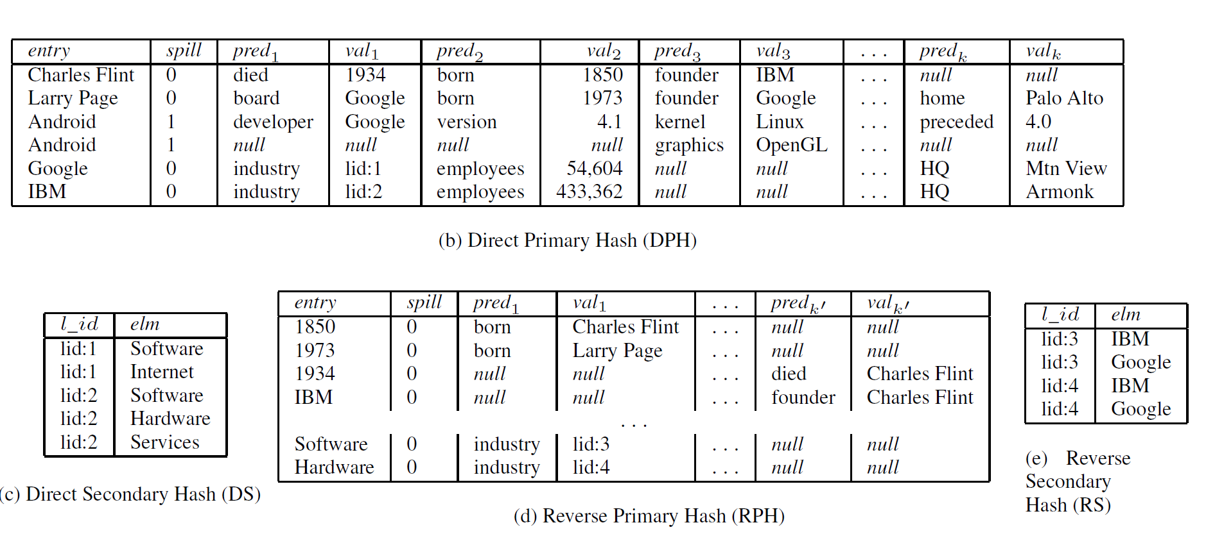
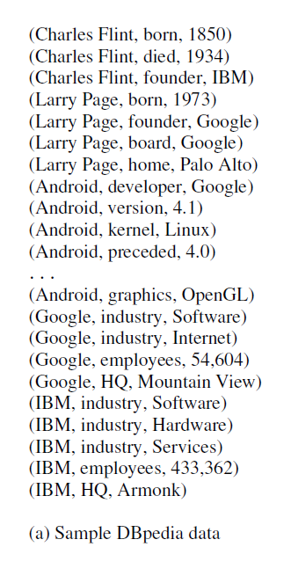
RDF over Relational
If |pred(s)| > k, then ((|pred(s)|/k) + 1) tuples and spills into extra tuples

Slide 6
RDF over Relational
Direct Secondary Hash (DS)- used formultivalued-­attribute with help of unique identifier
Reverse Primary Hash (RPH)-to facilitate efficient of access, predicate to an object is considered
Reverse Secondary Hash (RS)-same as DS but for predicate to object

Slide 7
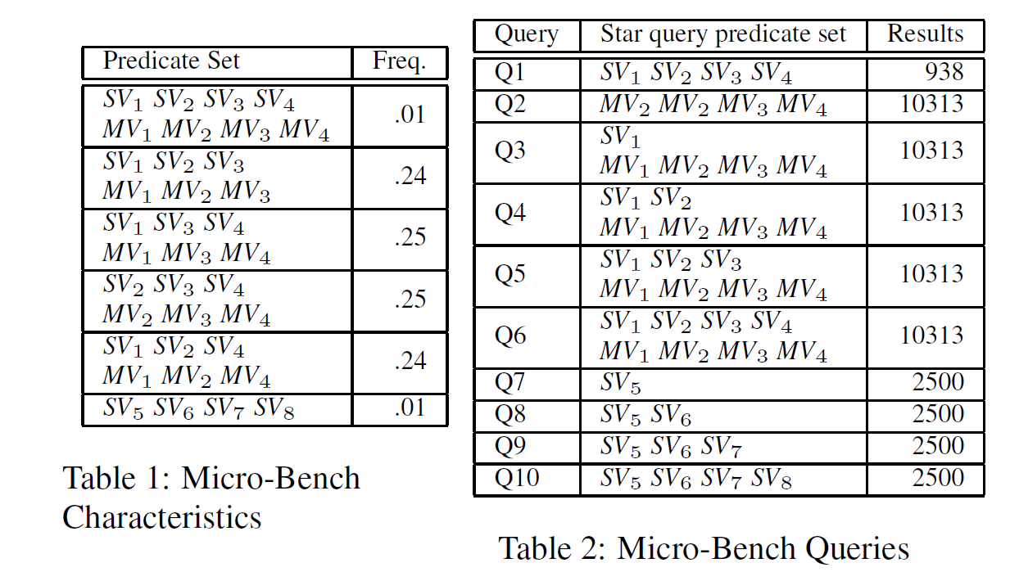
RDF over Relational
Less number of joins in Star queries

Slide 8
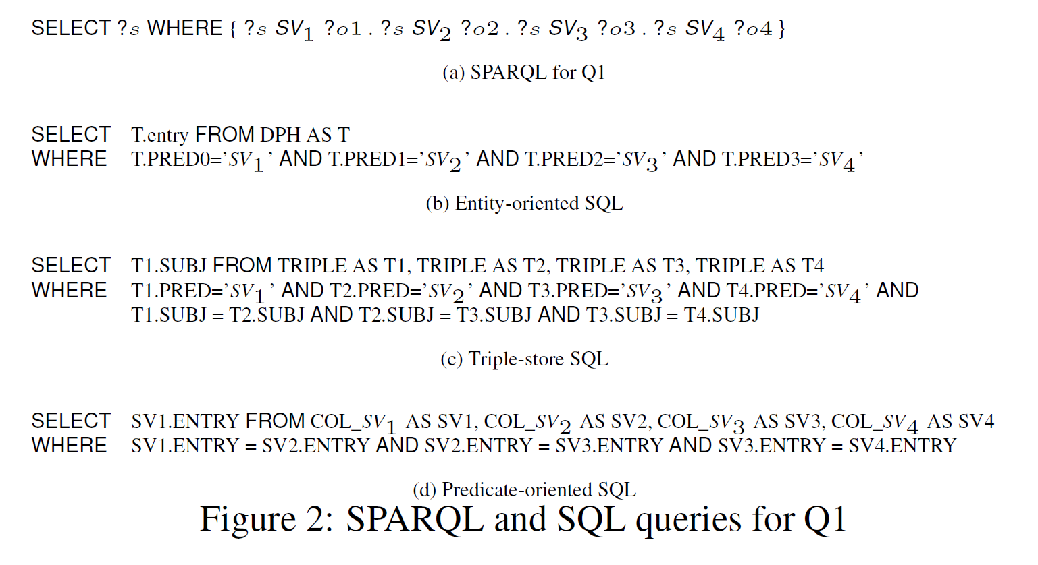
RDF over Relational

